Slide 1

Car Price Prediction
Submitted by:
ASHISH ANAND

Slide 2
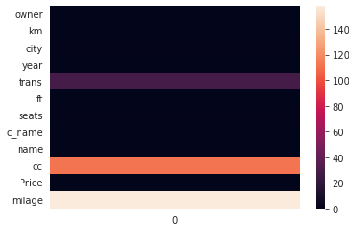
NULL values in dataset

Slide 3
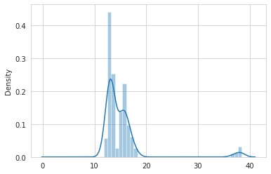
Distribution plot of log(price)

Slide 4
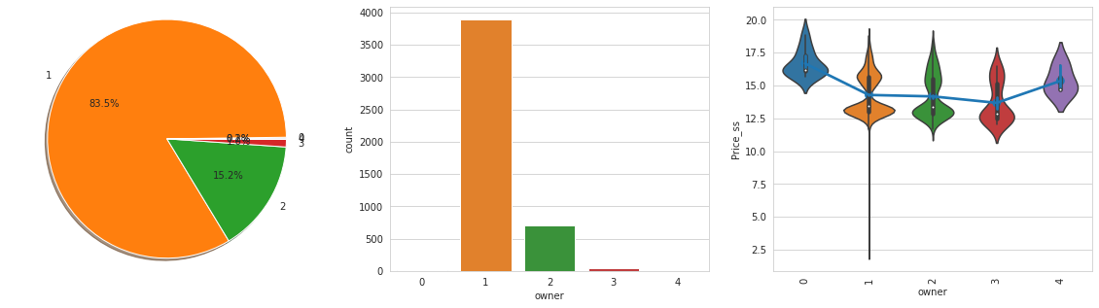
car price of owners 1 and four are higher than the rest.

Slide 5
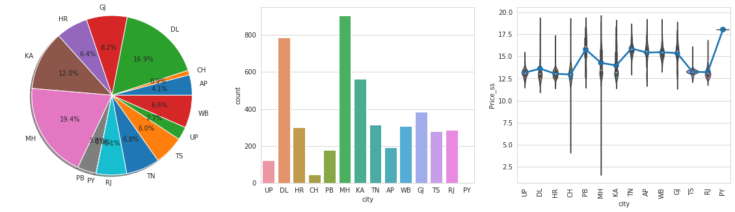

Slide 6
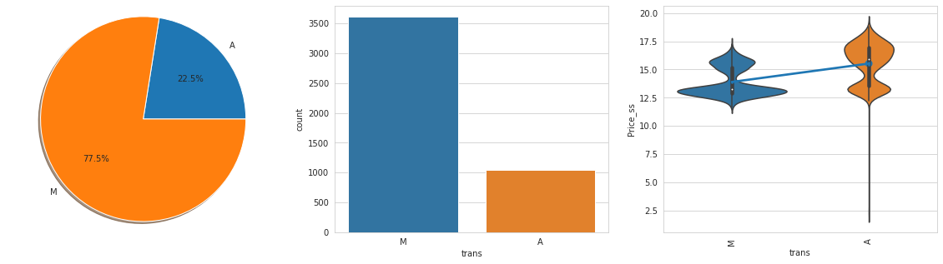

Slide 7
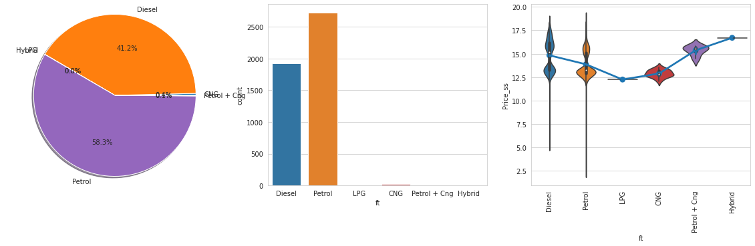

Slide 8
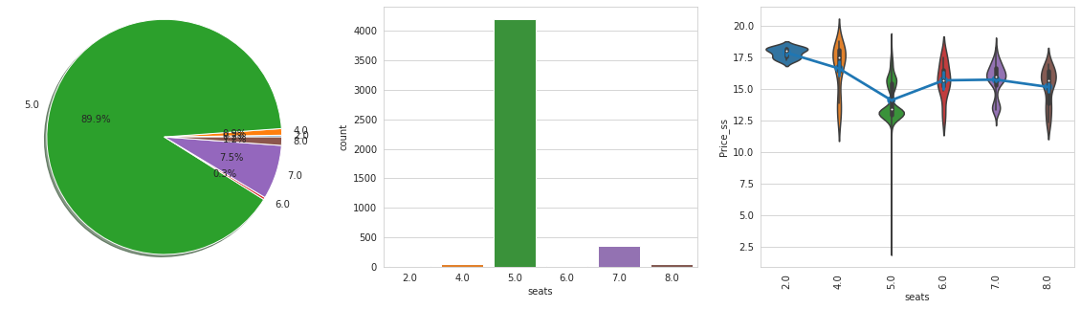

Slide 9
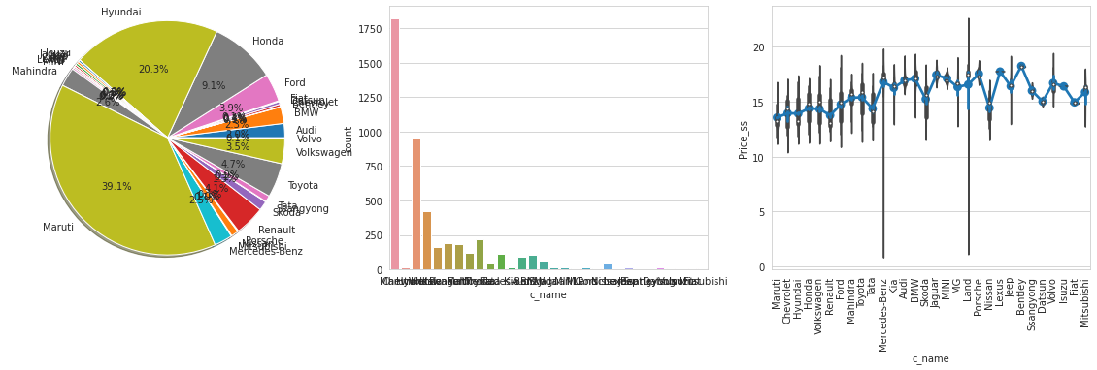

Slide 10
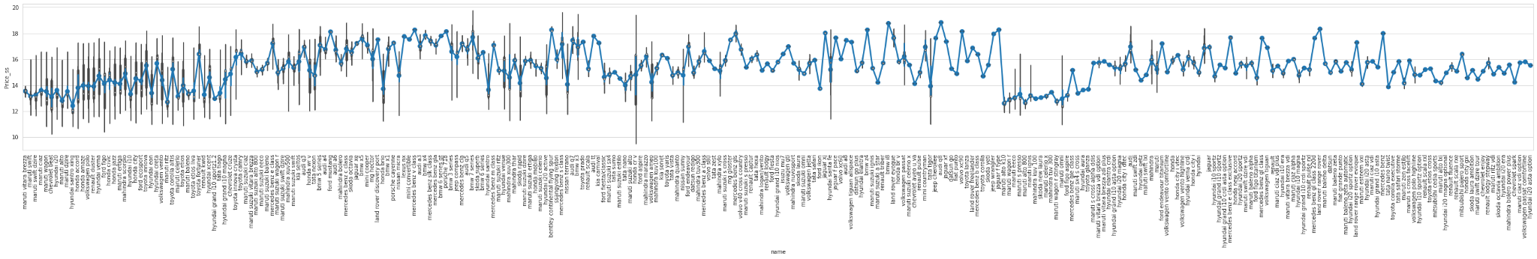

Slide 11
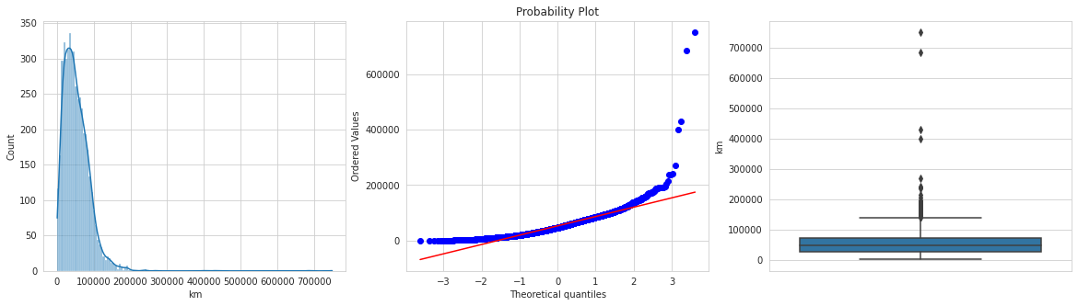
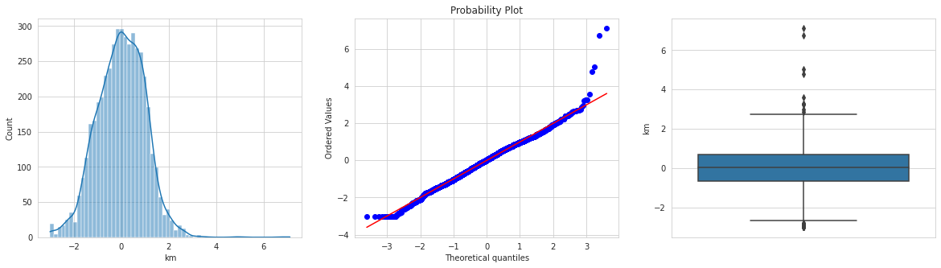

Slide 12
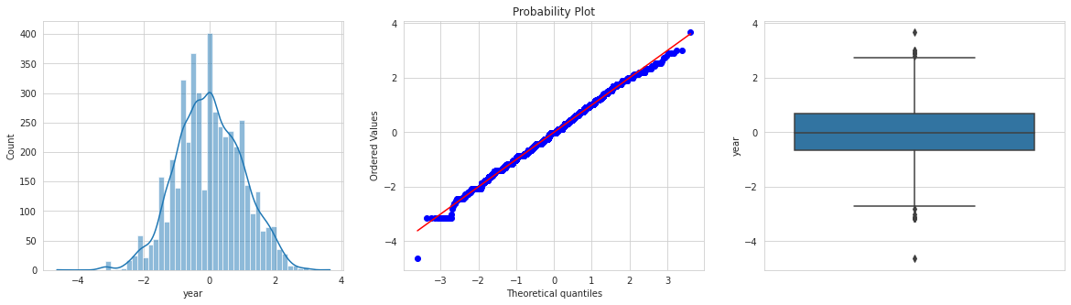
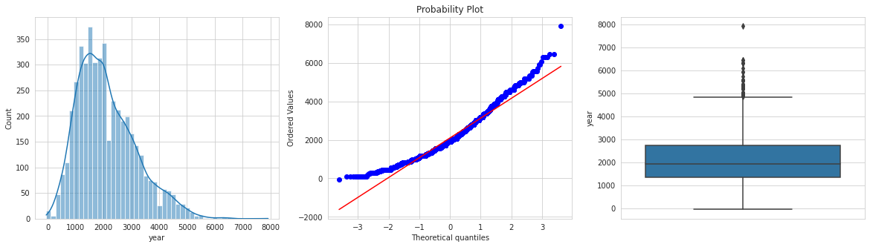

Slide 13
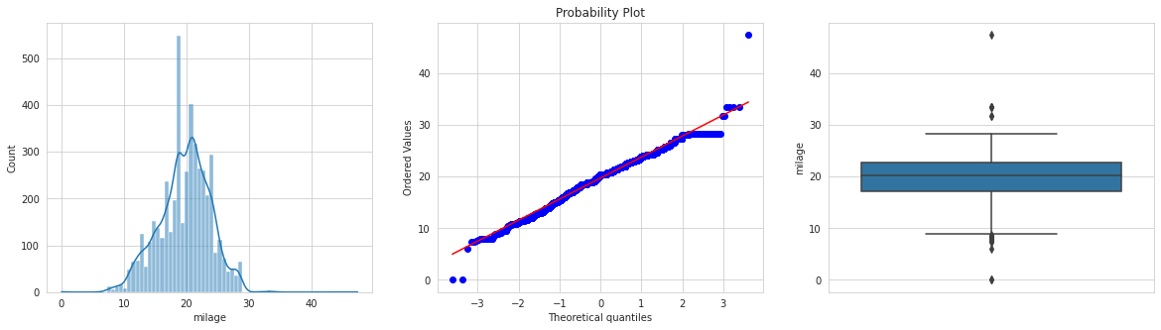
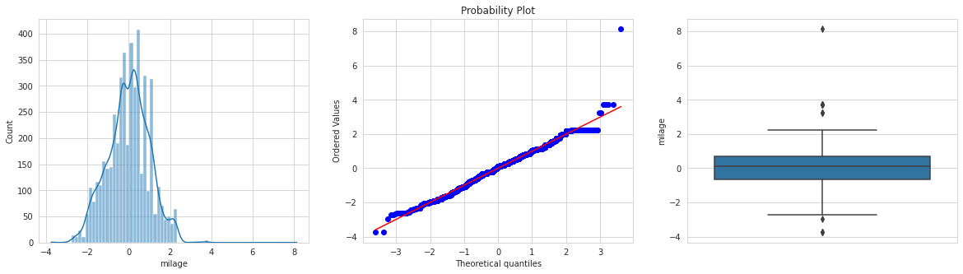

Slide 14
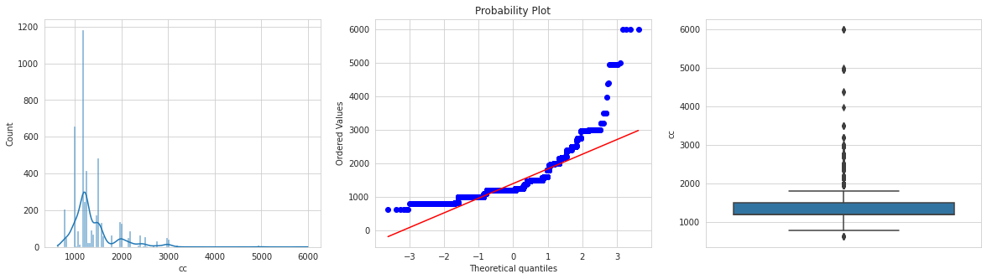
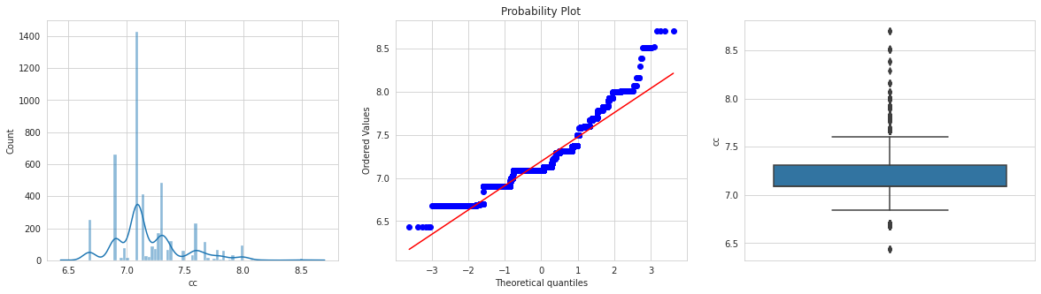

Slide 15
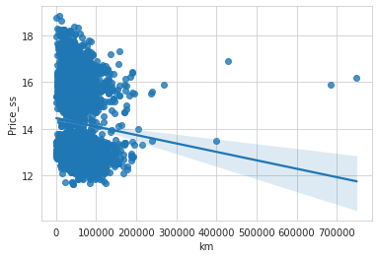

Slide 16
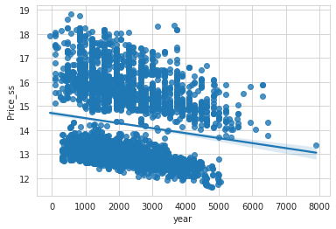

Slide 17
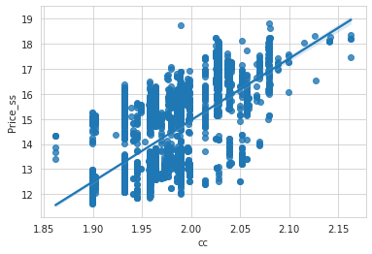

Slide 18
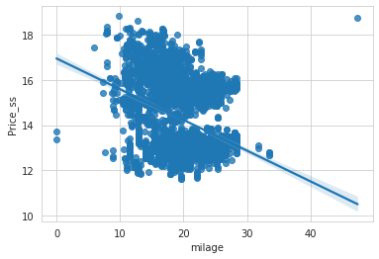

Slide 19
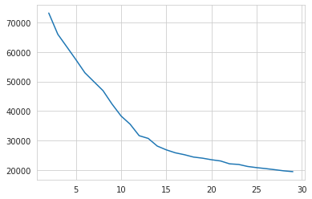
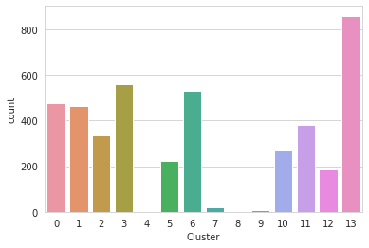

Slide 20
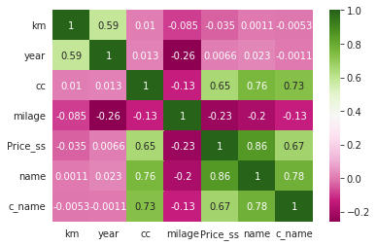

Slide 21
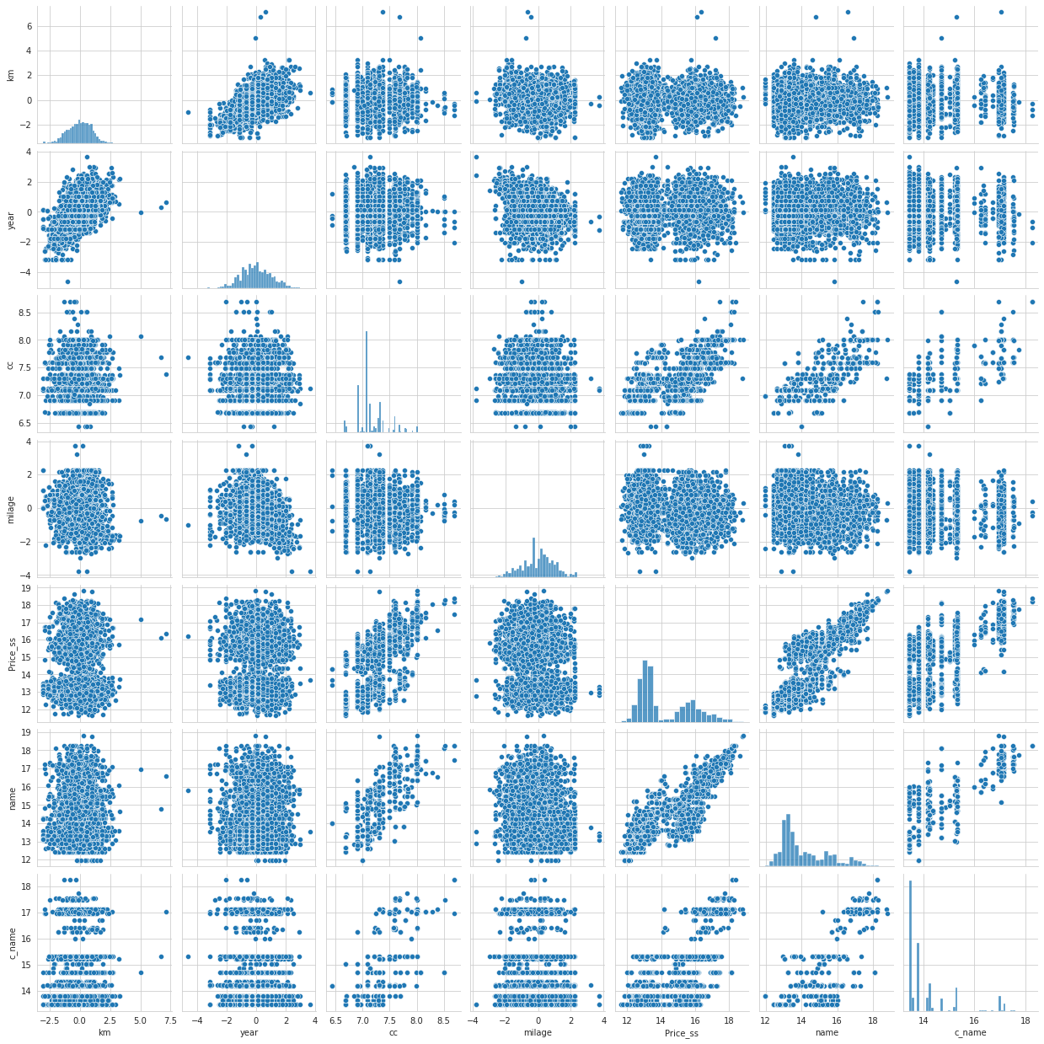

Slide 22
CONCLUSION
car price of owners 1 and four are higher than the rest.
car price has a 0.8 correlation with car price.
The manual transmission has a lower price than automatic transmission.
LPG and CNG e v type car has lower price than the rest of the car
Company name has very high variance in its price range
Km driven is negatively correlated with the price of the car
Year use of ka is negatively correlated with the price of the car
The engine capacity of the car is very highly correlated with the price of the car
Mileage is negatively correlated with the price of the car

